Slide 1
Deep Transformers with Latent Depth
Xian Li1 , Asa Cooper Stickland2 , Yuqing Tang1 , and Xiang Kong1
Advances in Neural Information Processing Systems 33 pre-proceedings (NeurIPS 2020)
Source code : Fairseq October 2020: Deep Transformer with Latent Depth code released
Presenter : Bumjin Park

Slide 2
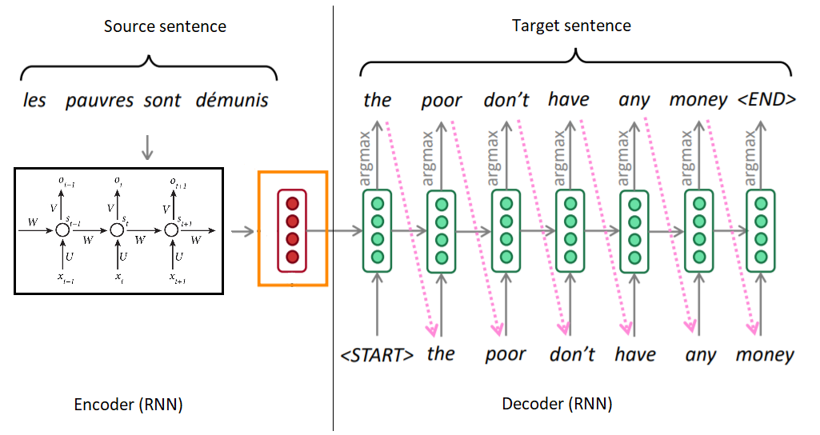
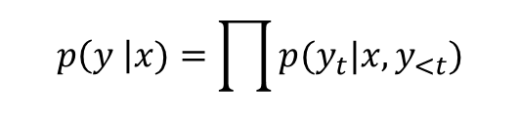
Introduction Text Generation
X
Y
$$p\left(y \right|x)=\prod{p(y_{t}|x, y_{<t}})$$
Notes:
Text Generation Task
Started from RNN Neural Network
Objective is to maximize the probability of y given x
But this architecture may be too simple

Slide 3
Introduction Transformer
Output Probability
Output Probability
Softmax
Softmax
Stacking Layers
Linear
Linear
Decoder
Decoder
Add & Norm
Feed Forward
Encoder
Decoder
Encoder
Add & Norm
Add & Norm
Feed Forward
Multi-Head Attention
Encoder
Decoder
Add & Norm
Add & Norm
Multi-Head Attention
Masked Multi-Head Attention
Encoder
Decoder
Positional Encoding
Positional Encoding
+
+
Input
Embedding
Output
Embedding
Input
Embedding
Output
Embedding
Inputs
Outputs (shifted right)
Inputs
Outputs (shifted right)
Notes:
In 2017, there was the paper attention is all you need.
Same encoder and decoder architecture but more complex structure inside
The transformer doesn’t feed x sequentially, the transformer learns the relationship in x by itself.

Slide 4







Introduction Transformer
$$B×Y_{len}×V$$
Output Probability
Output Probability
Softmax
Softmax
Stacking Layers
Linear
Linear
$$B×Y_{len}×D$$
Decoder
Decoder
Add & Norm
Feed Forward
$$B×X_{len}×D$$
Encoder
Decoder
Encoder
Add & Norm
Add & Norm
Feed Forward
Multi-Head Attention
Encoder
Decoder
Add & Norm
Add & Norm
Multi-Head Attention
Masked Multi-Head Attention
Encoder
Decoder
Positional Encoding
Positional Encoding
$$B×X_{len}×D$$
$$B×Y_{len}×D$$
+
+
Input
Embedding
Output
Embedding
Input
Embedding
Output
Embedding
Outputs (shifted right)
Inputs
Outputs (shifted right)
$$B×X_{len}$$
$$B×Y_{len}$$
Inputs
Notes:
In 2017, there was the paper attention is all you need.
Same encoder and decoder architecture but more complex structure inside
The transformer doesn’t feed x sequentially, the transformer learns the relationship in x by itself.

Slide 5



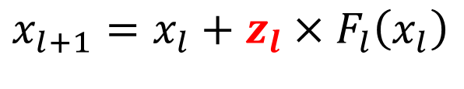
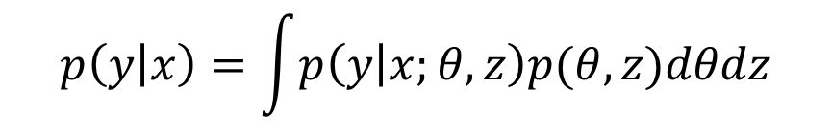

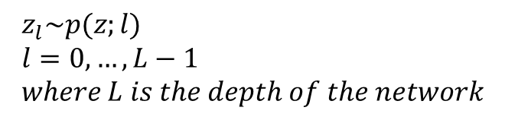
Deep Transformer with Latent Depth Latent Layer Selection
Transformer
…
$$x_{l+1}=x_{l}+F_{l}\left(x_{l}\right)$$
Transformer Layer
$$F_{l+1}$$
$$p\left(y | x\right)=\int{p\left(y | x;θ\right)dθ}$$
Transformer with latent depth
Transformer Layer
$$F_{l}$$
$x_{l+1}=x_{l}+z_{l}×F_{l}\left(x_{l}\right)$
$$z_{l}\sim p(z;l) \\ l=0,…,L−1 \\ where L is the depth of the network$$
…
$$p\left(y | x\right)=\int{p\left(y | x;θ,z\right)p(θ, z)dθdz}$$

Slide 6
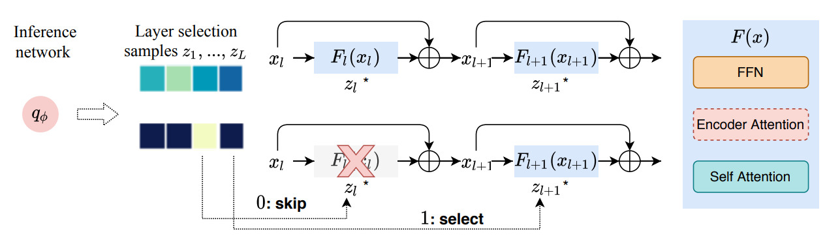
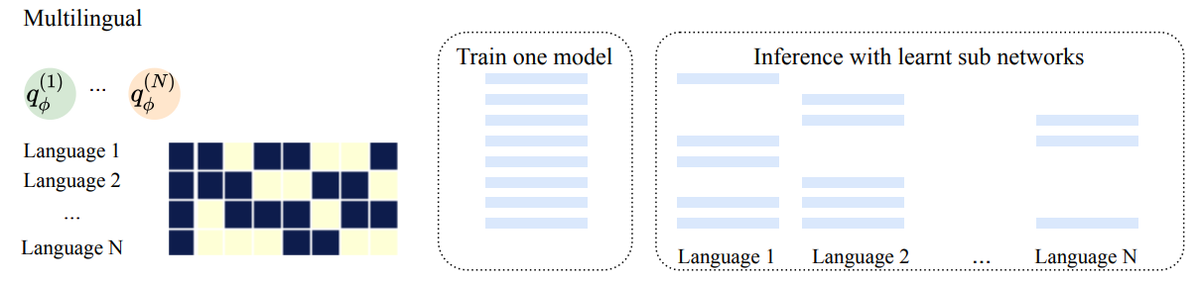
Deep Transformer with Latent Depth Latent Layer Selection

Slide 7
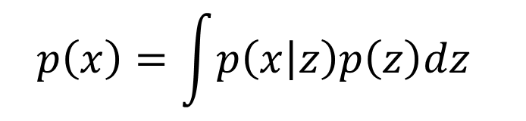

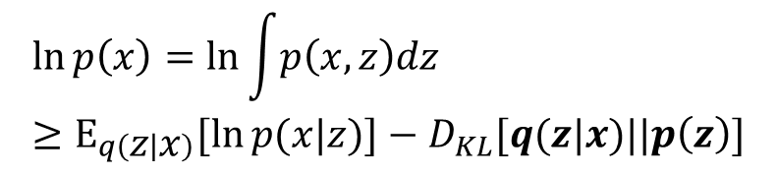
Background VAE
AutoEncoder
Z
$$x≈x′$$
$$p\left(x\right)=\int{p\left(x | z\right)p\left(z\right)dz }$$
Variational AutoEncoder
Mu
$$\ln{p\left(x\right)}=\ln{\int{p\left(x,z\right)dz }} \\ ≥Ε_{q\left(z | x\right)}[\ln{p(x|z)]}−D_{KL}[q(z|x)||p\left(z\right)]$$
Var
Reconstruction
Regularization
Notes:
What was the variational autoencoder
The posterior of the latent variable given the data point is regularized by the prior of the latent variable.

Slide 8
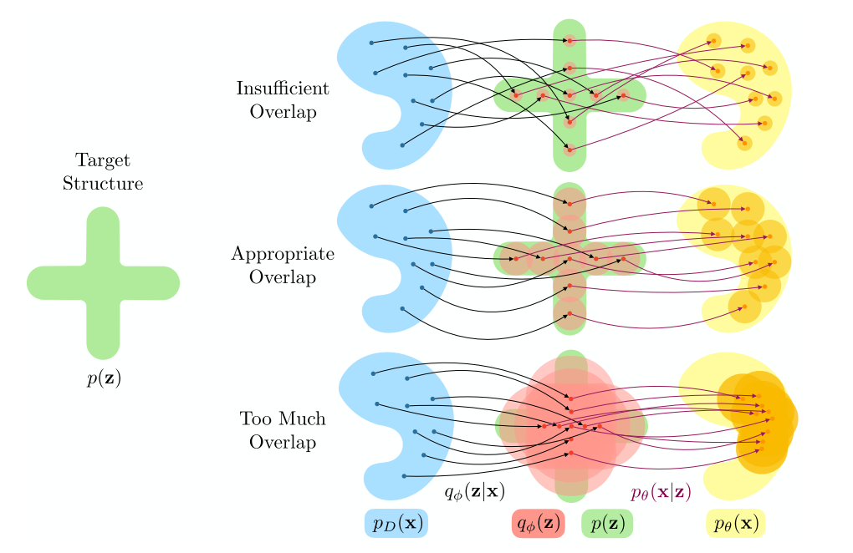
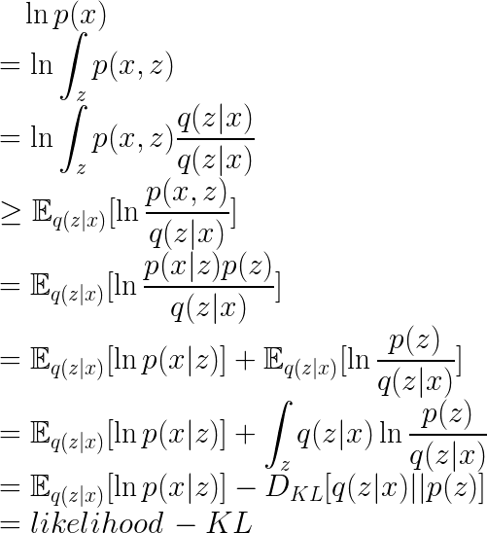
Background Training the latent space
AutoEncoder
Posterior Collapse
Notes:
What is the training of VAE
There should be appropriate overlap between the

Slide 9
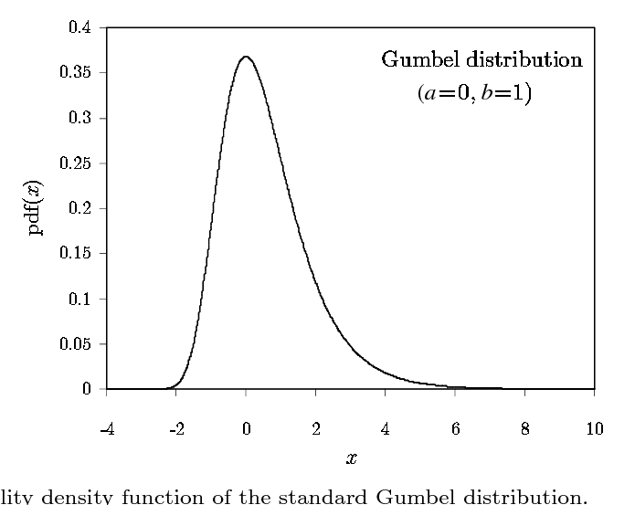


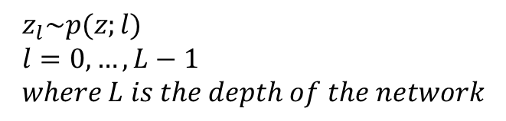
Deep Transformer with Latent Depth Latent Layer Selection
$x_{l+1}=x_{l}+z_{l}×F_{l}\left(x_{l}\right)$
$$z_{l}\sim p(z;l) \\ l=0,…,L−1 \\ where L is the depth of the network$$
1. $z_{l} \sim ℬ\left(π;l\right), π\sim (0,1)$ : Bernoulli distribution Select or Skip
2. Marginalizing over $z$ becomes intractable when $l$ grows large → Variational inference
3. Maximize the evidence lover bound(ELBO)
${\log{p\left(y | x\right)≥Ε}}_{q_{φ(z)}}\left[\log{p_{θ}\left(y | x,z\right)}\right]−D_{KL}(q_{φ}(z)||p\left(z\right))$
4. Gumbel-Softmax reparameterization to sample from the approximate posterior $q_{φ}\left(z\right)$ → end-to-end differentiable while learning (approximately) discrete policies
$$z_{l}^{i}\left(α_{l}\right)= \frac{exp⁡(\frac{α_{l}\left(i\right)+ε\left(i\right)}{τ})}{\sum_{i∈\{0,1\}}{exp⁡(\frac{α_{l}\left(i\right)+ε\left(i\right)}{τ})}}, ε \sim 𝒢(0,1)$$

Slide 10
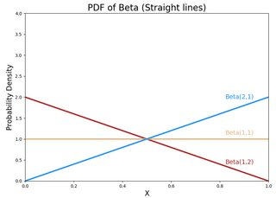

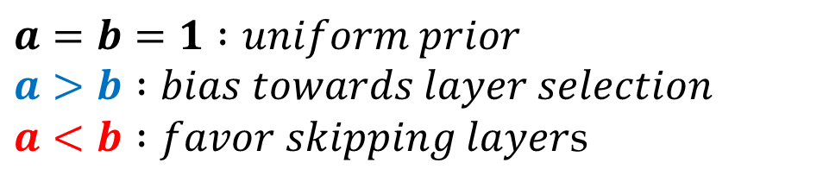
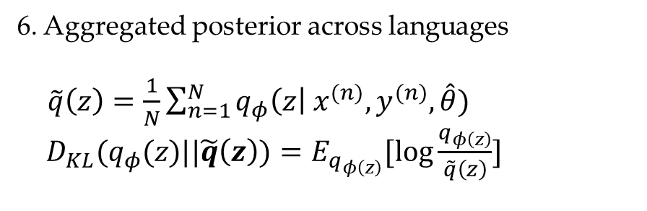
Deep Transformer with Latent Depth Latent Layer Selection
$x_{l+1}=x_{l}+z_{l}×F_{l}\left(x_{l}\right)$
$$z_{l}\sim p(z;l) \\ l=0,…,L−1 \\ where L is the depth of the network$$
${\log{p\left(y | x\right)≥Ε}}_{q_{φ(z)}}\left[\log{p_{θ}\left(y | x,z\right)}\right]−D_{KL}(q_{φ}(z)||p\left(z\right))$
5. $p\left(z\right)$ : conjugate prior $Beta(a,b)$
$a=b=1 :uniform prior$ $a>b :bias towards layer selection$
$a<b :favor skipping layer$s
6. Aggregated posterior across languages
$\tilde{q}\left(z\right)=\frac{1}{N}\sum_{n=1}^{N}{q_{φ}\left(z\right| x^{(n)}, y^{(n)}, \hat{θ}})$ $D_{KL}(q_{φ}(z)||\tilde{q}\left(z\right))=E_{q_{φ\left(z\right)}}[\log{\frac{q_{φ\left(z\right)}}{\tilde{q}\left(z\right)}}]$

Slide 11
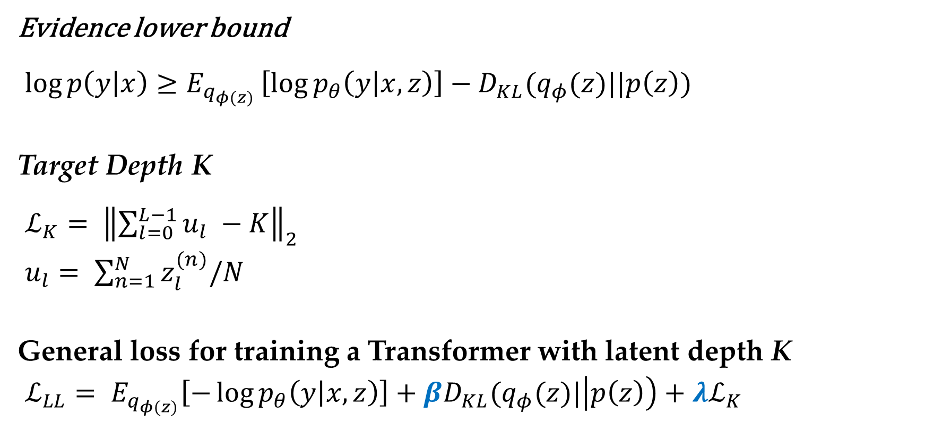
Objective
Evidence lower bound ${\log{p\left(y | x\right)≥Ε}}_{q_{φ(z)}}\left[\log{p_{θ}\left(y | x,z\right)}\right]−D_{KL}(q_{φ}(z)||p\left(z\right))$
Target Depth K $ℒ_{K}= {\left\|\sum_{l=0}^{L−1}{u_{l} −K}\right\|}_{2}$
$u_{l}= \sum_{n=1}^{N}{z_{l}^{(n)}/N}$
General loss for training a Transformer with latent depth K
$ℒ_{LL}= E_{q_{φ(z)}}\left[−\log{p_{θ}\left(y | x,z\right)}\right]+βD_{KL}(q_{φ}(z)|\left|p\left(z\right)\right)+λℒ_{K}$
L : total number of layers
N : total number of languages

Slide 12
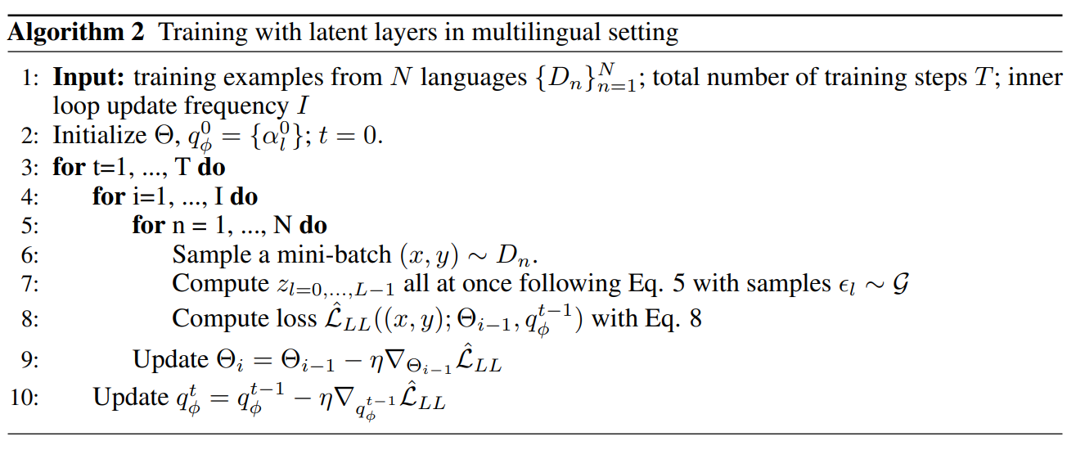
Deep Transformer with Latent Depth Training

Slide 13
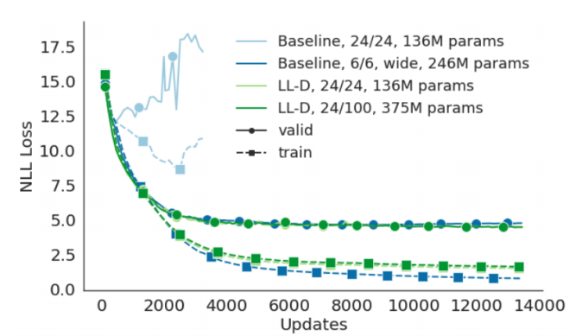
Baseline
#Encoder Layers / #Decoder Layers
Diverged
Converged

Slide 14
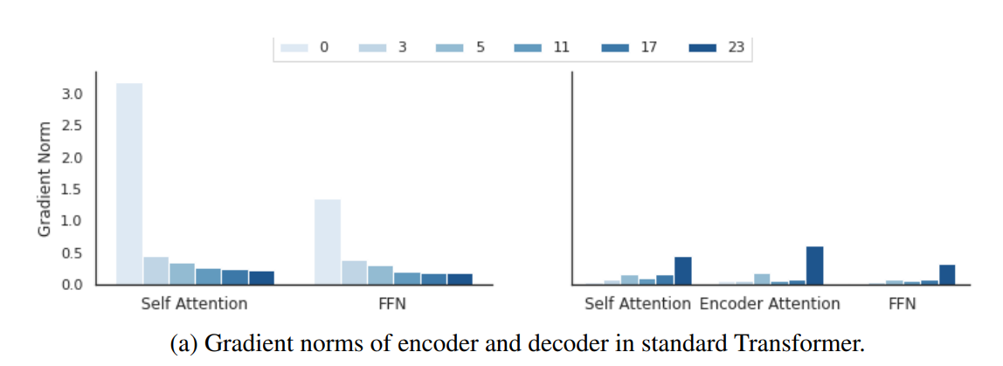
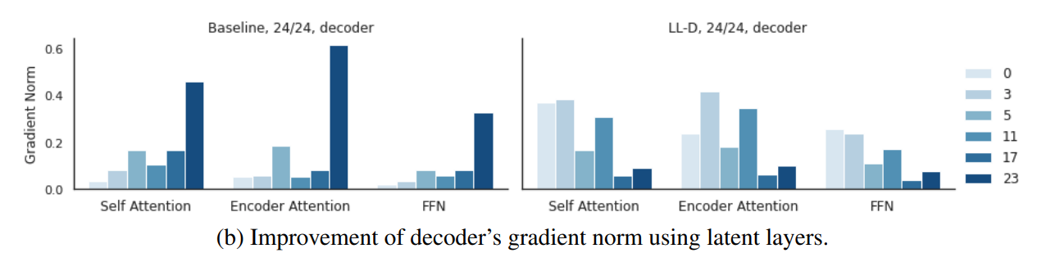
Gradient norm of each layer
Standard Transformer Encoder
Standard Transformer Decoder
Standard Transformer Decoder
Layer Latent Depth Model Decoder

Slide 15
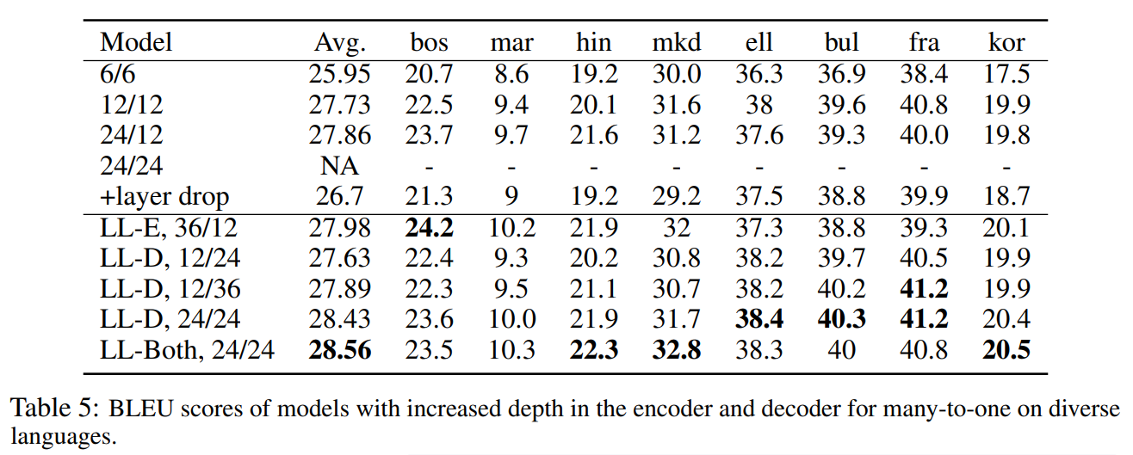
Comparing the transformer and LLD
Languages

Slide 16
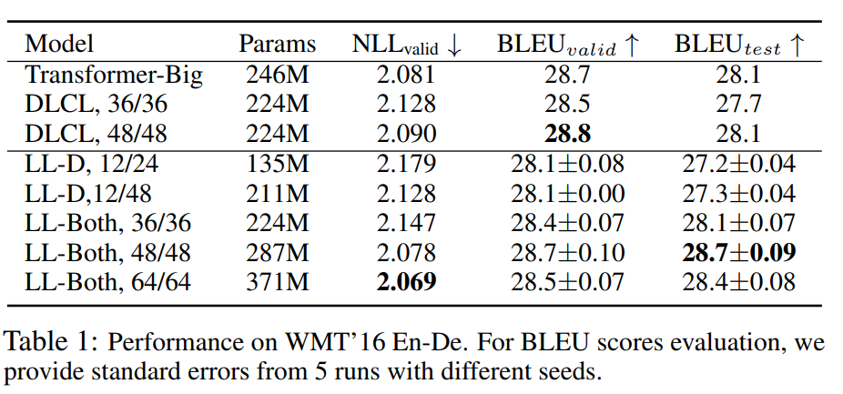
Increasing Depth

Slide 17
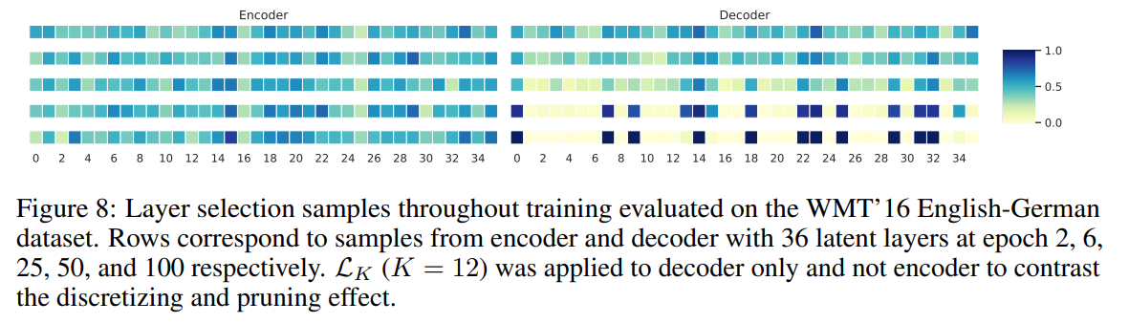

$z\sim p(z;l)$ while training
Epoch
Layers
Layers

Slide 18
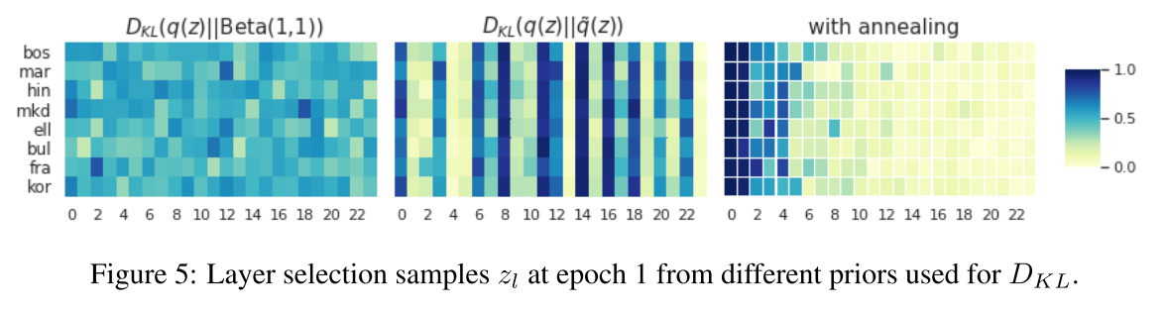
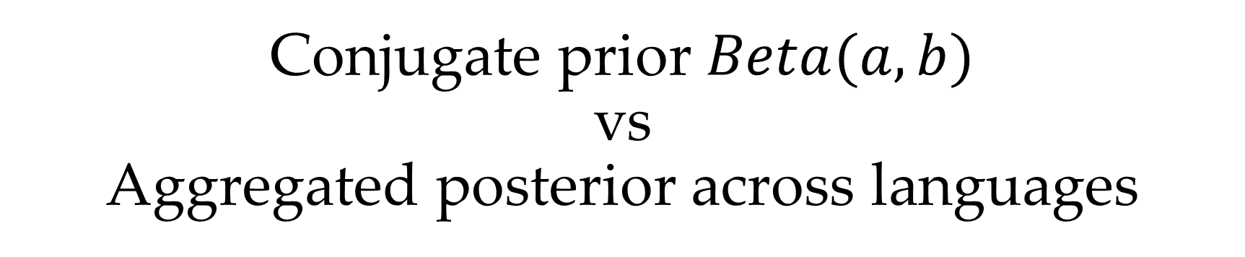
Conjugate prior $Beta(a,b)$ vs Aggregated posterior across languages
Bottom layer first Continuous

Slide 19

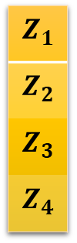

Question Discussion
Output Probability
Softmax
Linear
$x_{l+1}=x_{l}+z_{l}×F_{l}\left(x_{l}\right)$
Add & Norm
$z_{l} \sim ℬ\left(π;l\right), π\sim (0,1)$
Feed Forward
$$Z_{1}$$
$$Z_{2}$$
$$Z_{3}$$
$$Z_{4}$$
Add & Norm
Add & Norm
Feed Forward
Multi-Head Attention
Add & Norm
Add & Norm
Multi-Head Attention
Masked Multi-Head Attention
Positional Encoding
Positional Encoding
+
+
Input
Embedding
Output
Embedding
Inputs
Outputs (shifted right)

